Slide 1
Tech Instagram Influencer Analysis

Slide 2
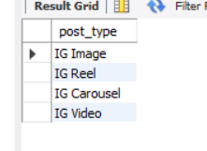
How many unique post types are found in the 'fact_content' table?
Query:-
SELECT distinct post_type From fact_content;
Output:-

Slide 3
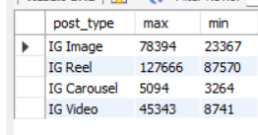
2. What are the highest and lowest recorded impressions for each post type?
Query:-
SELECT post_type,(impressions) as max,MIN(impressions) as min From fact_content group by post_type;
Output:-

Slide 4
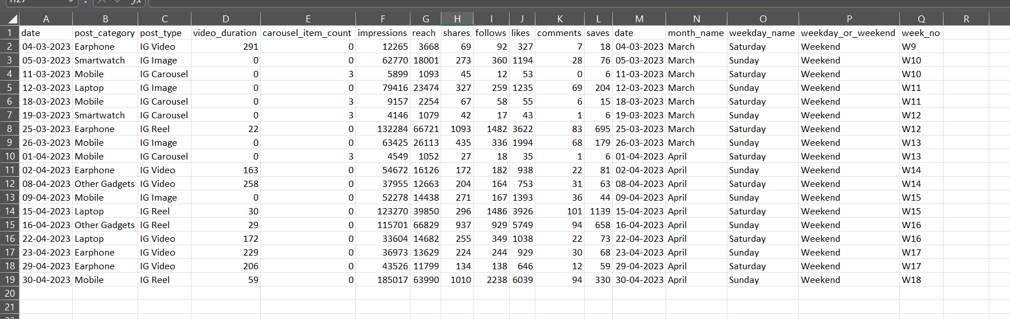
3. Filter all the posts that were published on a weekend in the month of March and April and export them to a separate csv file.
Query:-
Select * from fact_content f join dim_dates d on f.date=d.date where weekday_or_weekend="weekend" and month_name IN ("March","April");
Output:-

Slide 5
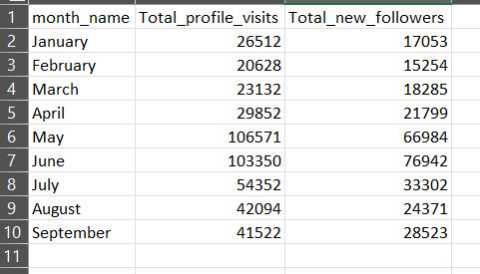
4.Create a report to get the statistics for the account. The final output includes the following fields:
• month_name
• total_profile_visits
• total_new_followers
Query:-
select d.month_name,SUM(f.profile_visits) as Total_profile_visits,SUM(f.new_followers) as Total_new_followers from dim_dates d join fact_account f on d.date=f.date group by d.month_name;
Output:-

Slide 6
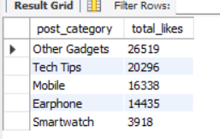
5.Write a CTE that calculates the total number of 'likes’ for each 'post_category' during the month of 'July' and subsequently, arrange the 'post_category' values in descending order according to their total likes.
Query:-
WITH post_category_like AS (select f.post_category,SUM(f.likes) as Total_likes from fact_content f join dim_dates d on f.date=d.date where d.month_name='July' group by post_category)SELECT post_category, total_likes FROM post_category_like ORDER BY total_likes DESC;
Output:-

Slide 7
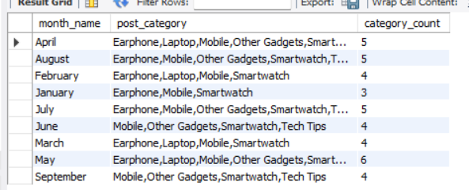
6. Create a report that displays the unique post_category names alongside their respective counts for each month. The output should have three columns:
• month_name
• post_category_names
• post_category_count
Example:
'April', 'Earphone,Laptop,Mobile,Other Gadgets,Smartwatch', '5' • 'February', 'Earphone,Laptop,Mobile,Smartwatch', '4’
Query:-
select d.month_name,GROUP_CONCAT(distinct post_category ORDER BY post_category SEPARATOR ',') as post_category,COUNT(distinct post_category) AS category_count from fact_content f join dim_dates d on f.date=d.date group by month_name;
Output:-

Slide 8
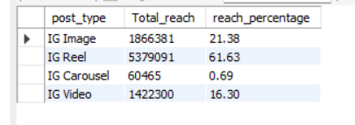
7. What is the percentage breakdown of total reach by post type? The final output includes the following fields:
• post_type
• total_reach
• reach_percentage
Query:-
select post_type,sum(reach) as Total_reach,ROUND(SUM(reach) * 100.0 / (select SUM(reach) FROM fact_content), 2) AS reach_percentage from fact_content group by post_type;
Output:-

Slide 9
8.Create a report that includes the quarter, total comments, and total saves
recorded for each post category. Assign the following quarter groupings:
(January, February, March) → “Q1”
(April, May, June) → “Q2”
(July, August, September) → “Q3” The final output columns should consist of:
post_category ,quarter ,total_comments ,total_saves
Query:-
select * from dim_dates;ALTER TABLE dim_datesADD COLUMN quarter VARCHAR(10);SET SQL_SAFE_UPDATES = 0;UPDATE dim_datesSET quarter = CASE WHEN month_name IN ('January', 'February', 'March') THEN 'Q1' WHEN month_name IN ('April', 'May', 'June') THEN 'Q2' WHEN month_name IN ('July', 'August', 'September') THEN 'Q3' ELSE 'Q4' END;SET SQL_SAFE_UPDATES = 1;select * from dim_dates;
select f.post_category,quarter,(f.comments) as Total_Comments,SUM(saves) as Total_Saves from fact_content f join dim_dates d on f.date=d.date group by post_category,quarter;

Slide 10
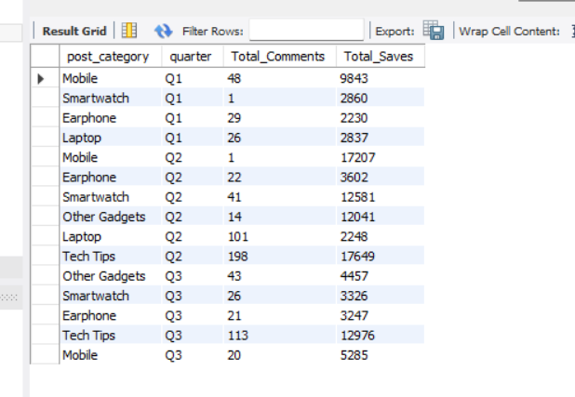
Output:-

Slide 11
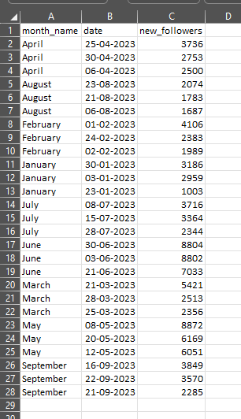
9.List the top three dates in each month with the highest number of new followers. The final output should include the following columns:
month
date
new_followers
Query:-
SELECT month_name,date,new_followersFROM ( SELECT d.month_name, f.date,
s.new_followers, ROW_NUMBER() OVER (PARTITION BY d.month_name ORDER BY
s.new_followers DESC) AS rn FROM fact_content f JOIN dim_dates d ON f.date = d.date
JOIN fact_account s
ON f.date = s.date) tWHERE rn <= 3ORDER BY month_name,new_followers DESC;

Slide 12
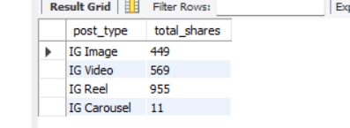
10.Create a stored procedure that takes the 'Week_no' as input and generates a report displaying the total shares for each 'Post_type'. The output of the procedure should consist of two columns:
post_type
total_shares
Query:-
CREATE DEFINER=`root`@`localhost` PROCEDURE `Get_Shares_ByWeek`(IN input_week varchar(4))BEGIN SELECT f.post_type, SUM(f.shares) AS total_shares FROM fact_content f JOIN dim_dates d ON f.date = d.date WHERE d.week_no = input_week GROUP BY f.post_type;END
call gdb0120.Get_Shares_ByWeek('W15’);
Output:-

